Slide 1
HTML - tables, forms
Viktoras Lava www.viktoraslava.lt

Slide 2
What is an attribute in HTML?
<a href=”#”>
google.com
</a>
Attribute is a modifier (setting) of an html element. It modifies the functionality of an element. Attribute is added to an HTML start tag.

Slide 3
Tables
<table>
<tr>
<td>1</td>
<td>2</td>
<td>3</td>
</tr>
</table>
Tables are used to display tabular data. Don’t use it for creating page layouts!
Table is defined within <table> tag
Row is defined within <tr> tag
Cell/data is defined within <td> tag
Simple table example is on the right -->

Slide 4
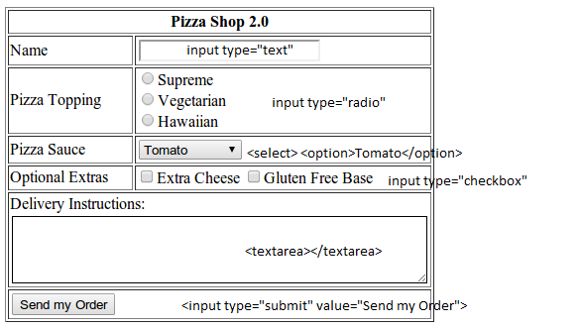
Forms
Forms are one of the main points of interaction between a user and a web site or application. Forms allow user to send data to the server
An HTML Form is made of widgets, these widgets can be text fields, select boxes, buttons, checkboxes, or radio buttons. Widgets are usually paired with labels that describe their purpose

Slide 5
Questions?

Slide 6
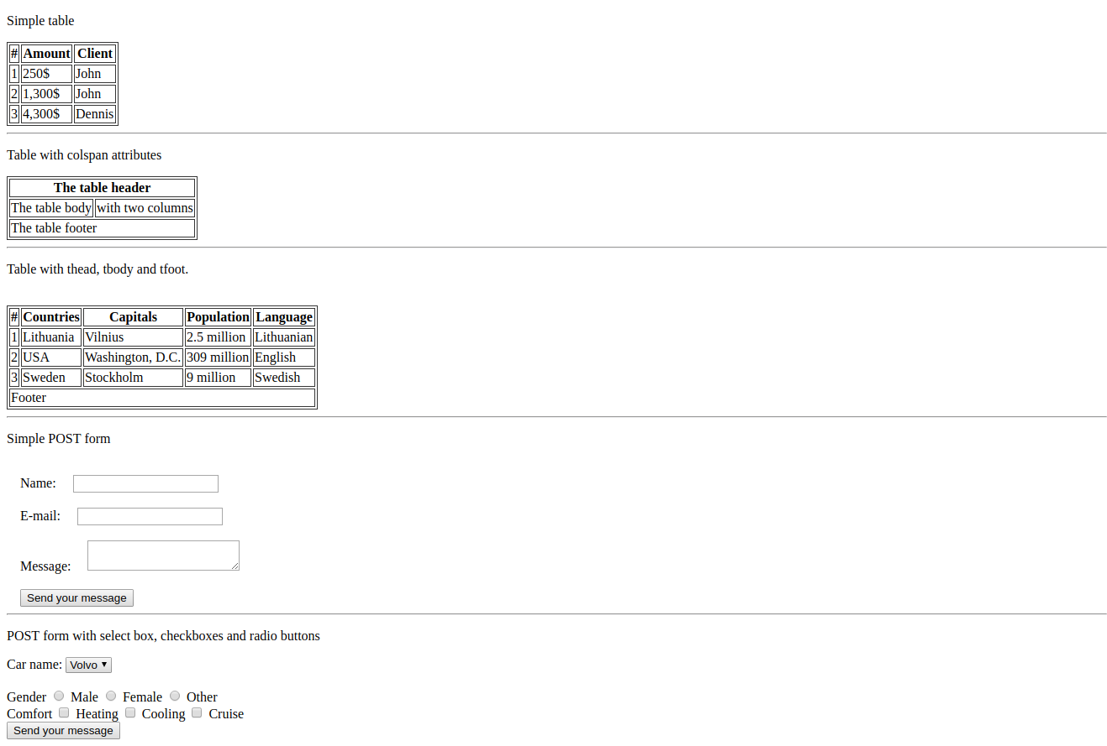
Homework
Do the homework task

